Slide 1
Sacchon Pfizer Hackathon George Moschovitis
05/2021

Slide 2
What follows
Challenges
Migration strategy
Postman collection
What has been refactored
Next Steps

Slide 3
Challenges
Local environment
"Fat jar" file
Limited time

Slide 4

Migration on-premise to AWS
Created and configured EC2 and RDS instances
Enabled and re-used security groups
Uploaded the Sacchon jar file into the EC2 instance

Slide 5
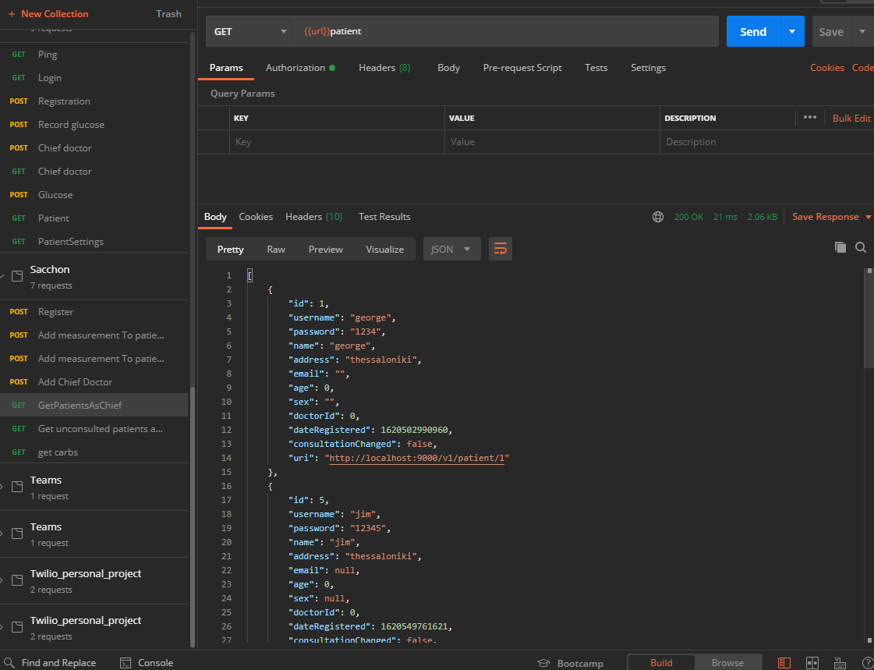
GET request Retrieving patients as a Chief Doctor

Slide 6
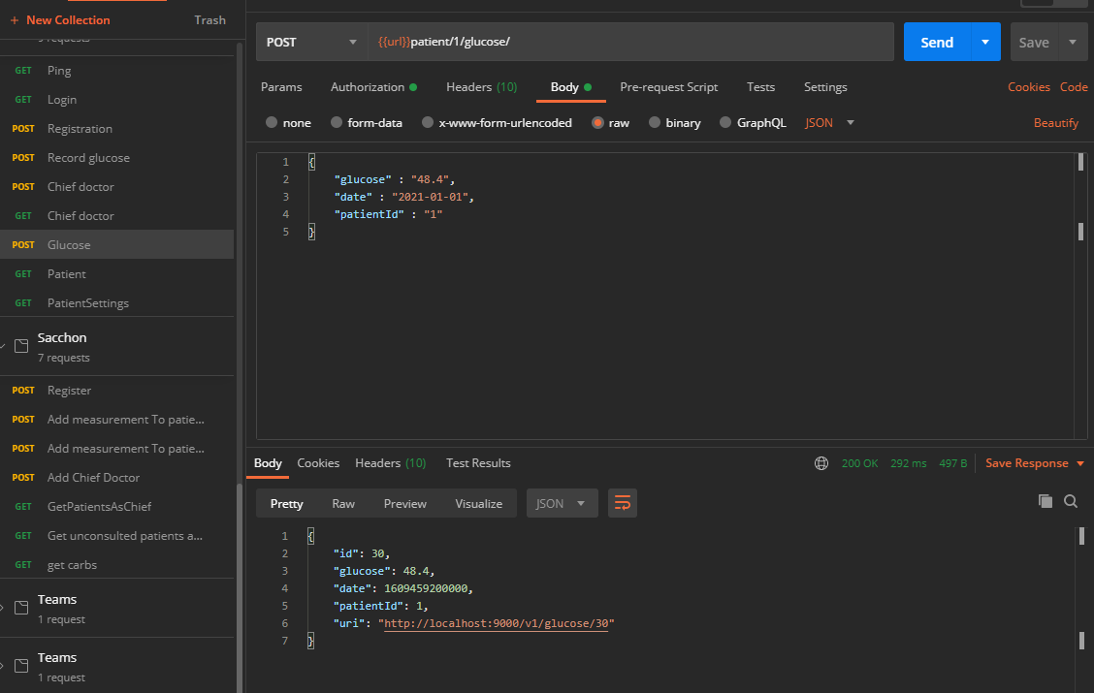
POST request Creating glycose data for a patient

Slide 7

What has been refactored
Implemented a Mapping library
Implemented the JWT partially
Refactored the API endpoint resources
Implemented a service layer

Slide 8

Major areas for further refactoring
Pagination, sorting and filtering
LocalDateTime replacing legacy date API
Memory leakage using entity manager
Authorization enhancements
GDPR compliance
Unit tests

Slide 9
About me
Self-improver
Analytical
Team player
Communication is key
360 focus

Slide 10

Highly appreciated
I would like to thank Pfizer and Code.Hub

